Slide 1
Infrastructure As Code
In this video, we will talk about Infrastructure as code. Infrastructure as code is using code to define and manage your infrastructure either in cloud or on premise. Infrastructure as code is about bringing software engineering principles and approaches into your infrastructure space. Instead of using manual process (which is prone to mistake) to deploy or update your Infrastructure, you can use software to push your latest changes.

Slide 2
Key concepts of infrastructure as code:
Repeatable process - is a set of actions that can be easily duplicated.
Consistent environments – This means your prod/QA environments are the same
Reusable components – Ability to reuse the code for future deployments
Documented architecture – Your entire infrastructure is well documented for easy troubleshooting.
Terraform:
In this tutorial, we are going to use Terraform – Terraform is vendor agonistic, that is you can use it in with any of the cloud provider – aws, google, azure
We will discuss Terraform:
Core components
Workflow
Installation

Slide 3
Core components –
Executable --- Configuration file (HCL) ---- Provider plugins ----- state data
Tasks
Install Terraform -- https://developer.hashicorp.com/terraform/downloads
Tryout the CLI commands
Create free AWS account
Prerequisites
Code editor
Exercise files

Slide 4
Terraform – Three concepts
Providers >>>>>>>>>>>>>> Resources >>>>>>>>>> Data Sources
Providers - Information about the provider you want to use i.e., for instance, we will be using aws, terraform will need our account information to access AWS.
Resources – what type of resource do we want to provision, i.e., do we want to provision a new EC2 or update existing configuration.
Data sources – are ways to query information from provider, this is also associated with provider.
https://github.com/ABOGOL2020/my_terraform_project

Slide 5
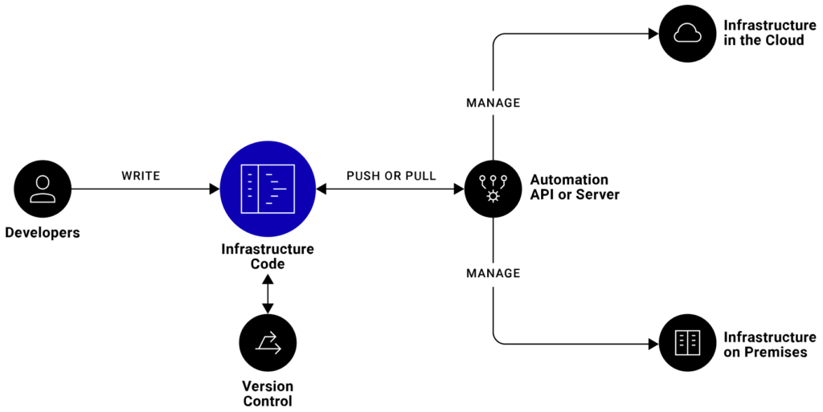

Slide 6

Inside the subnet, we will be creating a EC2 instance nginx as web server. Also, we will create security and route table group to allow web traffic to that web server
subnet-1

Slide 7
HCL configuration
resource “aws_instance” “web_server” {
name = “web-server”
ebs_volume {
size = 40
}
}
Terraform Object Reference
<resource_type>.<name_label>.<attribute>
aws_instance.web_server.name

Slide 8
Workflow:
Terraform Init – initiates provider plugins (i.e., AWS) by downloading all necessary plugins and create state data file.
Terraform plan – print out your changes to see what you want to deploy or modify. It compares your intended changes with your state data.
Terraform apply – Resources will be created or modified.
Terraform destroy -- This is very dangerous, in live production environment, please be careful

